Slide 2
Career and College Promise
Green Hope HS
Junior Night
Wake Technical Community College is accredited by the Southern Association of Colleges and Schools Commission on Colleges (SACSCOC) to award associate degrees. Wake Technical Community College also may offer credentials such as certificates and diplomas at approved degree levels. Questions about the accreditation of Wake Technical Community College may be directed in writing to the Southern Association of Colleges and Schools Commission on Colleges at 1866 Southern Lane, Decatur, GA 30033-4097, by calling 404-679-4500 or by using information available on SACSCOC's website (www.sacscoc.org).

Slide 3
Discussion Points
Introductions General Overview Pathways Option Eligibility Requirements
Expectations & Resources
Begin Application Process

Slide 4
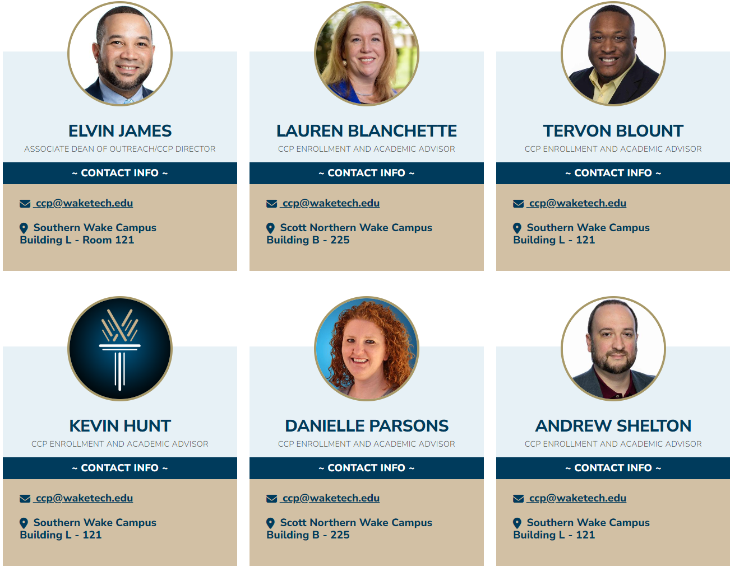
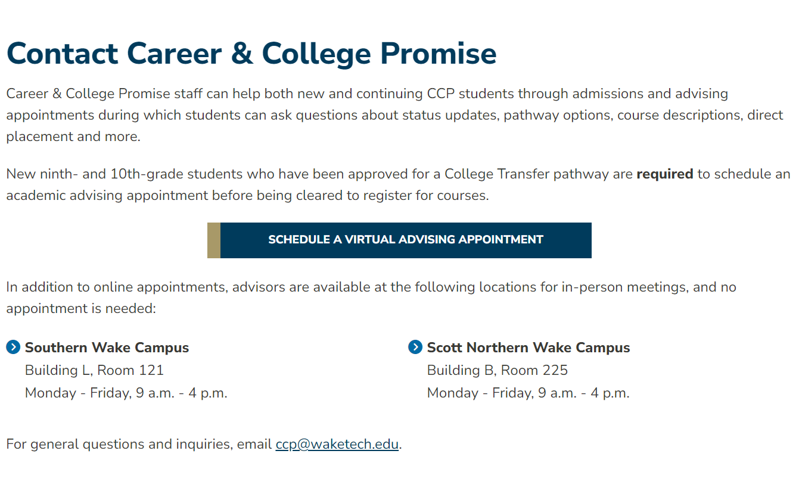
Career and College Promise Team
Notes:
NOTE(S):
The Career and College Promise Team at Wake Tech consists of various core team members (and support staff from the Wake Tech community) dedicated to assist all prospective and current students. For general questions and inquiries, emails can be sent to ccp@waketech.edu. Prospective and current students who are interested in speaking with a CCP team member during the enrollment cycle, can visit the CCP Admissions, Advising & Registration page (Transition Click) on the CCP Website (ccp.waketech.edu) to schedule a virtual appointment.
We will now discuss what the Career and College Promise program is and all that it entails...

Slide 5
What is Career & College Promise?
The Career and College Promise Program (CCP) is a dual-enrollment program designed to provide eligible
NC high school students an opportunity to
earn college credit while still in high school.
Career and College Promise is a state-mandated program administered by Wake Tech.
Notes:
NOTE(S):

Slide 6
Benefits of Enrolling in CCP…
Assists with admission into future college of choice – demonstrates college readiness and rigor
Introduces the “college experience” to students
Provides a jumpstart to career plans, job training, skills, and certifications

Slide 7
Benefits of Enrolling in CCP… (cont.)
Saves students and parents money on college tuition and lightens the course load for future college enrollment!
Tuition Comparison
CCP | Wake Tech | UNC | NC A&T | Campbell | NC State
$0 | $912 | $3,509 | $1,770 | $18,875 | $3,267
NOTE: Tuition costs listed are per 12 credit hours/semester for an In-State student… NOTE: Textbooks, fees, and other costs are not included in amounts listed…

Slide 10
Before you begin…
Are you a New Student or Continuing (Current) Student?

Slide 11
New Students vs Continuing (Current) Students
New Students
Students who have never been admitted into the CCP program at Wake Tech prior to the current term.
Required Enrollment Steps prior to course registration:
New Student Application Enrollment Form(s) Approval
Activate Wake Tech Account and Email
New Student Orientation
eLearning Intro (Online Courses Only)

Slide 12
New Students vs Continuing (Current) Students
Continuing (Current) Students
Students who have been previously admitted prior to the current term into the CCP program at Wake Tech.
Required Enrollment Steps prior to course registration:
Continuing (Current) Student Enrollment Form(s) Approval
eLearning Intro (Online Courses Only) *if not completed previously
Continuing Student Form and updated high school transcript required each term of enrollment

Slide 13
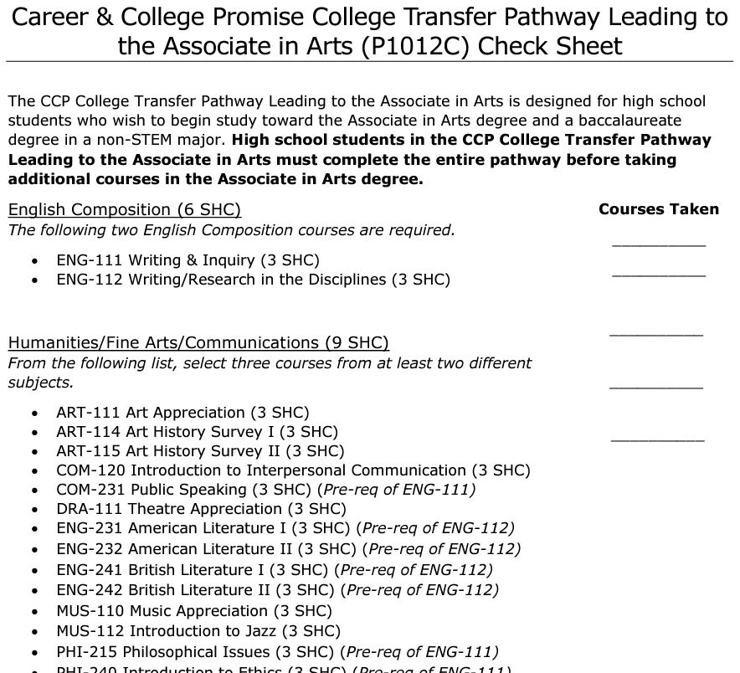
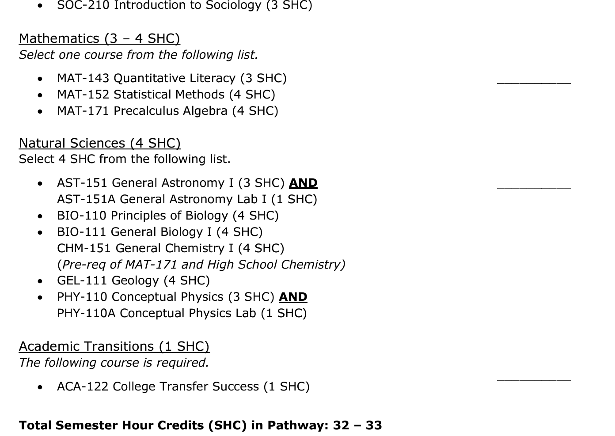
College Transfer (CT) Pathway
CT Leading to Associate Degree in Arts
Comprehensive Articulation Agreement with UNC System Institutions
Independent Comprehensive Articulation Agreement
For information on Transfer Resources, visit transfer.waketech.edu
Notes:
NOTE(S):
The College Transfer Pathway is designed for students who wish to begin earning college credit towards Wake Tech’s University Transfer degree programs which include an Associate in Arts, Arts Teacher Prep, Engineering, Fine Arts, Science, or Science Teacher Prep with the intent to transfer to a four-year college or university. Courses within the College Transfer Pathway options are considered UGETC courses, or Universal General Education Transfer Component courses. These courses are transferable to all public colleges and universities in North Carolina through the Comprehensive Articulation Agreement with UNC System Institutions. Courses are also transferable to private colleges and universities through the Independent Comprehensive Articulation Agreement. (Transition Click) To view the individualized Career and Technical Education and College Transfer Pathway options, visit the “Pathway Details” page on the CCP website.
(Transition Click) While on the designated page, we encourage that you explore the individual pathway options listed by clicking the PDF links. Each link will provide a program planning guide to display the approved courses within each pathway students are eligible to enroll in. As a notice, students are only allowed to enroll in courses within their approved pathway or pathways.
Now, let’s review eligibility requirements...

Slide 14
College Transfer (CT) Pathway Eligibility
Juniors and Seniors (11th & 12th)
Unweighted GPA of 2.8 on high school courses; or
Demonstrate college readiness in English, Reading, and Math (PSAT 10, PSAT/NMSQT, SAT, Pre-ACT, ACT, or Wake Tech RISE)
Notes:
NOTE(S):
For a freshman or sophomore interested in enrolling in the College Transfer Pathway, the student:
Must be identified by their local AIG plan in all areas (English/Reading and Math) or by Aptitude and Achievement test scores in the range of the 92nd and 99th percentiles from recommended Buros Center Tests; and
Demonstrate college readiness in English, Reading, and Math on an approved college readiness assessment; and
Have the recommendation of the high school principal (or equivalent administrator), via memo, verifying maturity to enroll; and
Have written consent of the student’s parent and or guardian; and
Participate in Mandatory Academic Advising
(Transition Click)
For a junior or senior interested in enrolling in the College Transfer Pathway, the student:
Must have an unweighted GPA of 2.8 or higher on high school courses; or
Demonstrate college readiness in English, Reading, and Math
As a note, waivers or letter of recommendations are not accepted for College Transfer Pathway enrollment in place of the GPA requirement and or test scores.

Slide 15
Things You Should Know Before Applying!
Students are only allowed up to four years of academic coursework One year as a Freshman, Sophomore, Junior and Senior only (Year: Fall/Spring/Summer)
CCP courses are actual college courses Students must earn a “C” or better in courses to transfer college credit earned Courses completed may appear on the student’s high school and college transcripts NOTE: Consult with high school representative to discuss transcript/graduation specifics
CCP Satisfactory Academic Progress Policy Students are required to maintain 2.0 GPA after the completion of two (2) college courses to remain eligible. Failure to meet policy will result in Academic Warning. Academic Suspension becomes effective if cumulative GPA is below 2.0 during subsequent term resulting in removal from the program
FERPA (Family Education Rights and Privacy Act) All rights to inspect and review the education record transfers from the parent to the student under FERPA when a student enters Wake Tech on the first day of class
Notes:
NOTE(S):
Here are a few things that you should know before beginning your application process:
Students are only allowed up to four years of academic coursework; one year as a freshman, one year as a sophomore, one year as a junior and one year as a senior. 5th year and graduation extensions are not permitted. Students are required to continue to progress toward high school graduation.
Career and College Promise courses are actual college courses. Students must earn a grade of “C” or better in courses to transfer college credit earned. Also, courses completed may appear on the student’s high school and college transcripts. As a note, consult with a high school representative to discuss high school transcript and graduation specifics.
In accordance with the CCP Satisfactory Academic Progress Policy, a student must maintain a minimum GPA of 2.0 in college coursework after completing two courses. Failure to meet the satisfactory academic progress policy will result in “Academic Warning”. If a 2.0 cumulative GPA is not met after a subsequent semester of Academic Warning, the student will no longer be eligible to participate in CCP.
Per the Family Education Rights and Privacy Act (better known as FERPA), when a student, regardless of age, enters Wake Tech (as in attendance on the first day), all rights to inspect and review the education record transfers from the parent to the student under FERPA.

Slide 16
Things You Should Know Before Applying!
Students are required to follow all Wake Tech student policies and procedures
Students are highly encouraged to meet with high school representatives to discuss their intent to enroll. Discussion points may include…
Pathway Selection(s)
Course Planning
High School Schedule Restrictions
Other relatable topics
Notes:
NOTE(S):
Students are required to follow all Wake Tech student policies and procedures
Lastly, students are highly recommended to meet with high school representatives to discuss their intent to enroll in program

Slide 17
Attendance, Grades & Satisfactory Academic Progress
Attendance Policy
Absences
A class absence is defined as missing one-third or more of any regularly scheduled class meeting.
Students who know of upcoming absences should notify their instructors in advance. If advance notice is not possible, students should contact instructors immediately upon their return to class.
Students are expected to attend at least 90% of all scheduled class meetings. If a student's absences in a class exceed 10% and are not justified to the satisfaction of the instructor, that instructor will submit an online withdrawal form to Registration and Student Records documenting the student's last date of attendance.
Course Entry Quiz (Hybrid and Online Courses)
Your entry into each online class is the Course Entry Quiz. You must complete the quiz by the 10% point of the semester to remain in the class.

Slide 18
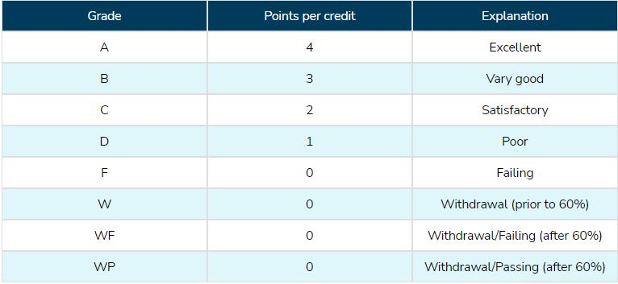
Attendance, Grades & Satisfactory Academic Progress
Grades
Grade Points
e
Grades of W and WP will not be used in computing grade point averages

Slide 19
Attendance, Grades & Satisfactory Academic Progress
Grades (cont.)
Enrollment reports are sent to local high school partners.
WTCC Transcript
Drop
Doesn’t appear on transcript
Request must be made by 10% point of term/session
Withdrawal
Request made after the 10% point of term/session
Appears as a “W” on WTCC transcript
Withdrawal Fail
Request made after the designated withdrawal request deadline
Appears as a “WF” on WTCC transcript
Not Attended
Result as a failure to complete the course entry quiz for online/hybrid course(s)
Appears as a “NA” on WTCC transcript
It is the student’s responsibility to keep up with drop and withdrawal dates. Your high school may assign an ‘F’ or ‘WF’ for a withdrawal. Please talk to you high school designee about how withdrawals are listed on your high school transcript. Any question about how a class will be shown on your high school transcript is up to your high school. For any questions that relate to high school policies, please talk to your Dean of Students, CDC or Counselor.

Slide 20
Attendance, Grades & Satisfactory Academic Progress
Satisfactory Academic Progress
CCP/WTCC Academic Standing Policy (Effective Fall 2022)
A student must maintain a minimum of a 2.0 GPA in college coursework after completing two courses at Wake Tech. Failure to meet the Academic Standing Policy will be subject to “Academic Concern” and/or “Discontinuation of CCP Enrollment”.
Academic Concern
If a 2.0 cumulative GPA is not met during any initial term while a student is actively enrolled in the program, the student will receive a notice of “Academic Concern”. The notice will provide helpful information and resources to support the student for the upcoming subsequent semester in which the student plans to participate. Academic Concern will not remove/terminate a student from the CCP program.
Discontinuation of CCP Enrollment
If a 2.0 cumulative GPA is not met after a subsequent semester of Academic Concern, the student will no longer be eligible to participate in CCP. Discontinuation will not prevent students from enrolling at Wake Tech upon graduating from high school.

Slide 21
Campus Resources

Slide 22
Begin Application Process
Notes:
NOTE(S):

Slide 23
Thank You!
Notes:
NOTE(S):

